Slide 1

LinkedList Challenge
It's now time for a LinkedList challenge.
I'm going to ask you to use LinkedList functionality, to create a list of places, ordered by distance from the starting point.
And we want to use a ListIterator, to move, both backwards and forwards, through this ordered itinerary of places.
COMPLETE JAVA MASTERCLASS
LinkedList Challenge

Slide 2
LinkedList Challenge
First, create a type that has a town or place name, and a field for storing the distance from the start.
Next, create an itinerary of places or towns to visit, much like we've been doing in the last few videos.
Town | Distance from Sydney (in km)
Adelaide | 1374
Alice Springs | 2771
Brisbane | 917
Darwin | 3972
Melbourne | 877
Perth | 3923
COMPLETE JAVA MASTERCLASS
LinkedList Challenge

Slide 3
LinkedList Challenge
But this time, instead of Strings, you'll want to create a LinkedList of your place or town type.
Here we show a list of a few places in Australia, and their distances from Sydney.
Town | Distance from Sydney (in km)
Adelaide | 1374
Alice Springs | 2771
Brisbane | 917
Darwin | 3972
Melbourne | 877
Perth | 3923
COMPLETE JAVA MASTERCLASS
LinkedList Challenge

Slide 4
LinkedList Challenge
You'll create a LinkedList, ordered by the distance from the starting point, in this case Sydney.
Sydney should be the first element in your list.
You don't want to allow duplicate places to be in your list, for this data set.
Town | Distance from Sydney (in km)
Adelaide | 1374
Alice Springs | 2771
Brisbane | 917
Darwin | 3972
Melbourne | 877
Perth | 3923
COMPLETE JAVA MASTERCLASS
LinkedList Challenge

Slide 5
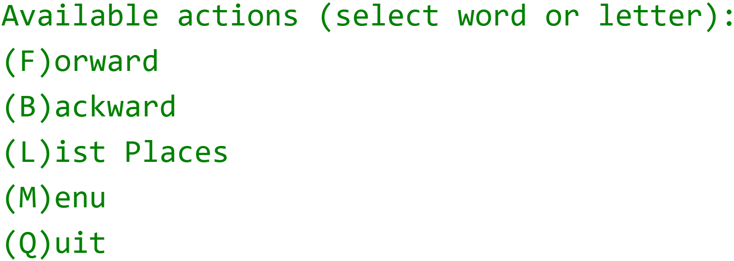
LinkedList Challenge
In addition, you'll create an interactive program with the following menu item options.
You'll want to use a Scanner, and the nextLine method, to get input from the console.
You'll use a ListIterator, to move forwards and backwards, through the list of places on your itinerary.
COMPLETE JAVA MASTERCLASS
LinkedList Challenge

